Slide 1
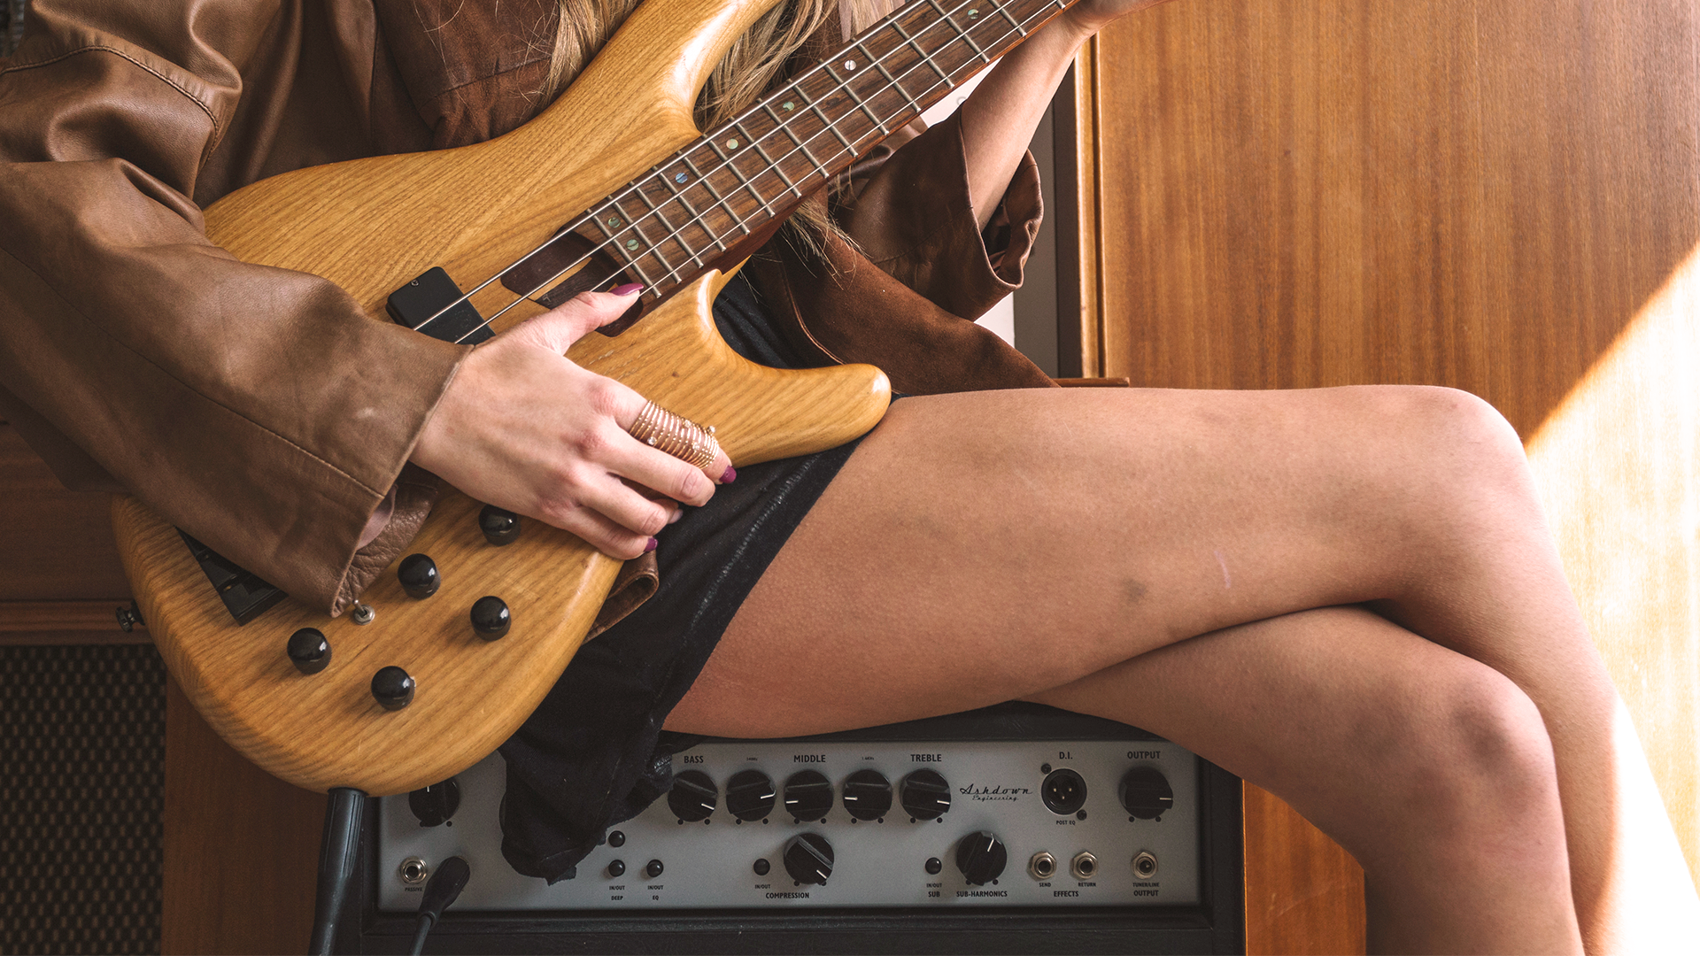
Billboard Hot 100 Sentiment & Recs
Aadithya Anandaraj,
LaShay Fontenot,
Haritha Maheshkumar,
Catherine Miao,
Sijo VM

Slide 2
PROBLEM STATEMENT
BUSINESS
CONSUMER
Will the song make it to the Top 25 Billboard?
Which song should I listen to next?

Slide 3
1 SONG & LYRIC SCRAPING
2B SENTIMENT ANALYSIS
APPROACH
2A TOPIC MODELING
3 RANK & RECS
Compile full list of songs from Billboard Top 100 and feed titles and artists into Genius to pull complete lyrics
Assess sentiment of each song’s lyrics using Vader (overall and across sentiments)
Determine list of topics across songs and topic percentage
Use outcomes of sentiment and topic modeling to attempt to predict song rank in the Top 100 and create song recommendations

Slide 4
11 years
DATA OVERVIEW
1100 songs
686 artists
Of Billboard Top 100 lists
Of varying genres with lyrics scraped from Genius
From Taylor Swift to Luke Bryan
Notes:
Talk about data preprocessing in this slide if necessary

Slide 5
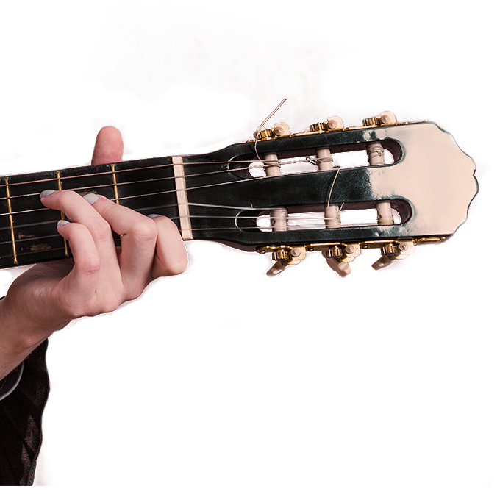
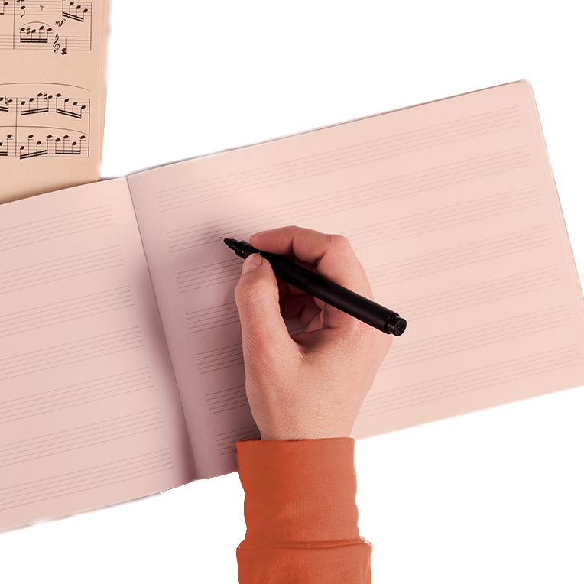
VADER SENTIMENT ANALYSIS
SENTIMENT ANALYSIS - PROCESS
POLARITY SCORES
Lexical method of obtaining sensitivity scores by building a lexicon or a ‘dictionary of sentiment’
The sentiment score of a song - calculated by summing up the sentiment scores of each VADER-dictionary-listed word in the lyrics
Scaled to -1 to 1 : most negative to most positive

Slide 6
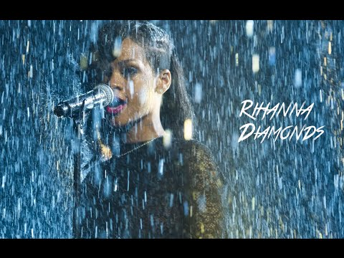

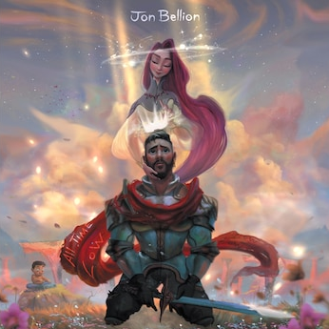
SENTIMENT SCORES
DIAMONDS
iSPY
ALL TIME LOW
Pos: 0.564
Neu: 0.436
Neg: 0
Pos: 0
Neu: 0.993
Neg: 0.007
Pos: 0.026
Neu: 0.247
Neg: 0.728

Slide 7
TOPIC MODELING
EXTRACTION OF TOPICS IN LYRICS
Topic Modeling produced 4 topics across all song lyrics
Topic 1
Topic 2
Topic 3
Topic 4
Party
Love
Dance
Money
Night, life, sexy, drink
Heart, love, baby, leave
Booty, hump, lean, rock
Money, grill,
best

Slide 8
RANK PREDICTION
Logistic Regressions | Class Weight | Accuracy | ROC | F1
1. Lyrics | Balanced | 0.83 | 0.89 | 0.70
2. Topic & Sentiment | Balanced | 0.74 | 0.53 | 0.50
3. Lyrics, Topic, Sentiment | Balanced | 0.82 | 0.90 | 0.70
Rank <= 25 ; High
Baseline Accuracy: 75%

Slide 9
CLUSTERING
SONG CLUSTERING
Using K-Means clustering we determined similar songs
Cluster 0
Cluster 1
Cluster 2
Cluster 3
Drake
Britney Spears
XXXtentacion
Imagine Dragons
Adele
Ed Sheeran
Beyonce
Miley Cyrus
Rihanna
Adele
Taylor Swift
Bruno Mars
Katy Perry
Lady Gaga
The Weeknd
Drake
Rihanna
P!nk
Lorde
Ke$ha
The results of this analysis could be used to place new music/artists near other popular songs when marketing

Slide 10
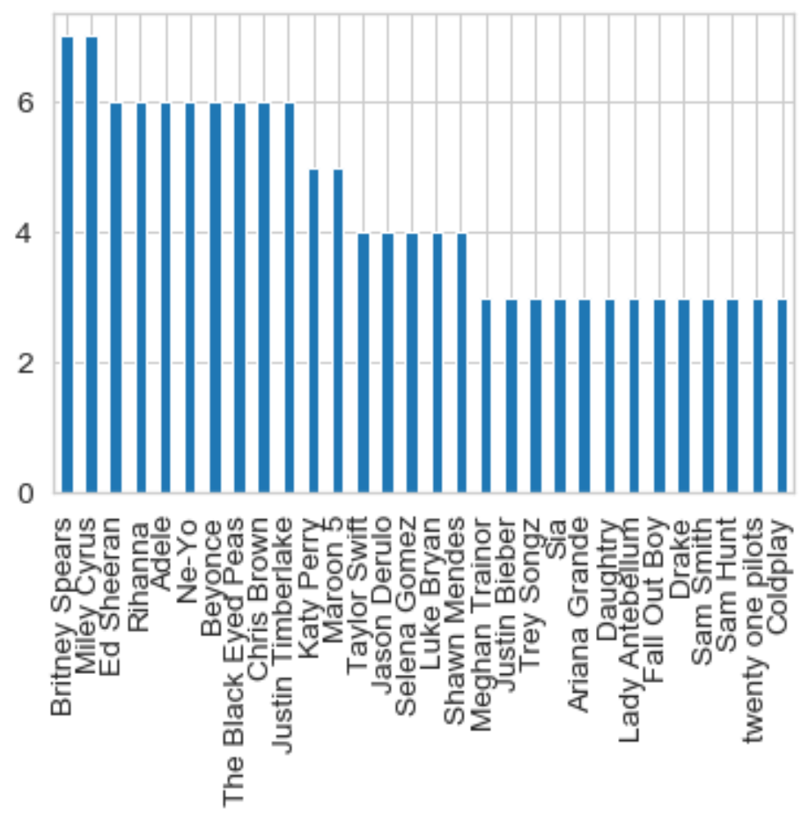
LONGTAIL ANALYSIS
SAME SAME BUT DIFFERENT
Clustering -> Longtail Curves (artists) -> Insights
HYPOTHESES
Differences in target market i.e. Britney Spears younger, party crowd vs Sam Hunt niche genre
Differences in music quality and production (‘danceability score’ etc.)
Music labels could focus on what could move songs further to the left, but be wary of making comparisons
Notes:
Recommendation : Have your song being co-mentioned along with the top occuring artist songs on blogs, social media sites and music events.

Slide 11
RECOMMENDATIONS
RECOMMENDATION PROCESS
Calculate Cosine Similarity among songs based on sentiment and topic modeling scores
1
2
Select input song
Produce recommendations using top similarity scores
3

Slide 12
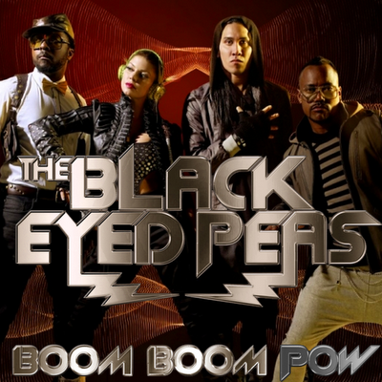
RECOMMENDATIONS
RECOMMENDATION EXAMPLE
Song : Boom Boom Pow by The Black Eyed Peas
Sentiment : Positive ( score .64)
Topic : Topic 1 (Party)
1
2
3
Vogue by Madonna
We Didn’t Start the Fire by Billy Joel
Live Your Life by T.I. Ft. Rihanna

Slide 13
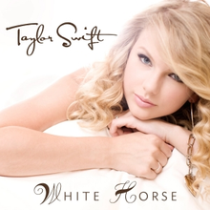
RECOMMENDATIONS
RECOMMENDATIONS
Song : White Horse by Taylor Swift
Sentiment : Positive ( score .89)
Topic : Topic 4 (Money)
1
2
3
Everything By Jody Watley
How Can I Fall? By Breather
Just Like Jesse James by Cher

Slide 14
INSIGHTS
SO WHAT?
Artists have freedom on choice of topics as they don’t seem to drive position on billboard
Lyrics are a big indicator of a song making it to Top 25
Sentiment distribution does not vary across low and high ranking songs - hinting to the fact that feelings don’t matter as long as the target market is right
Success is less about the sentiment and topic of the song and more about the total package and the target audience

Slide 15
THANKS!
QUESTIONS
Does anyone have any questions?

Slide 16
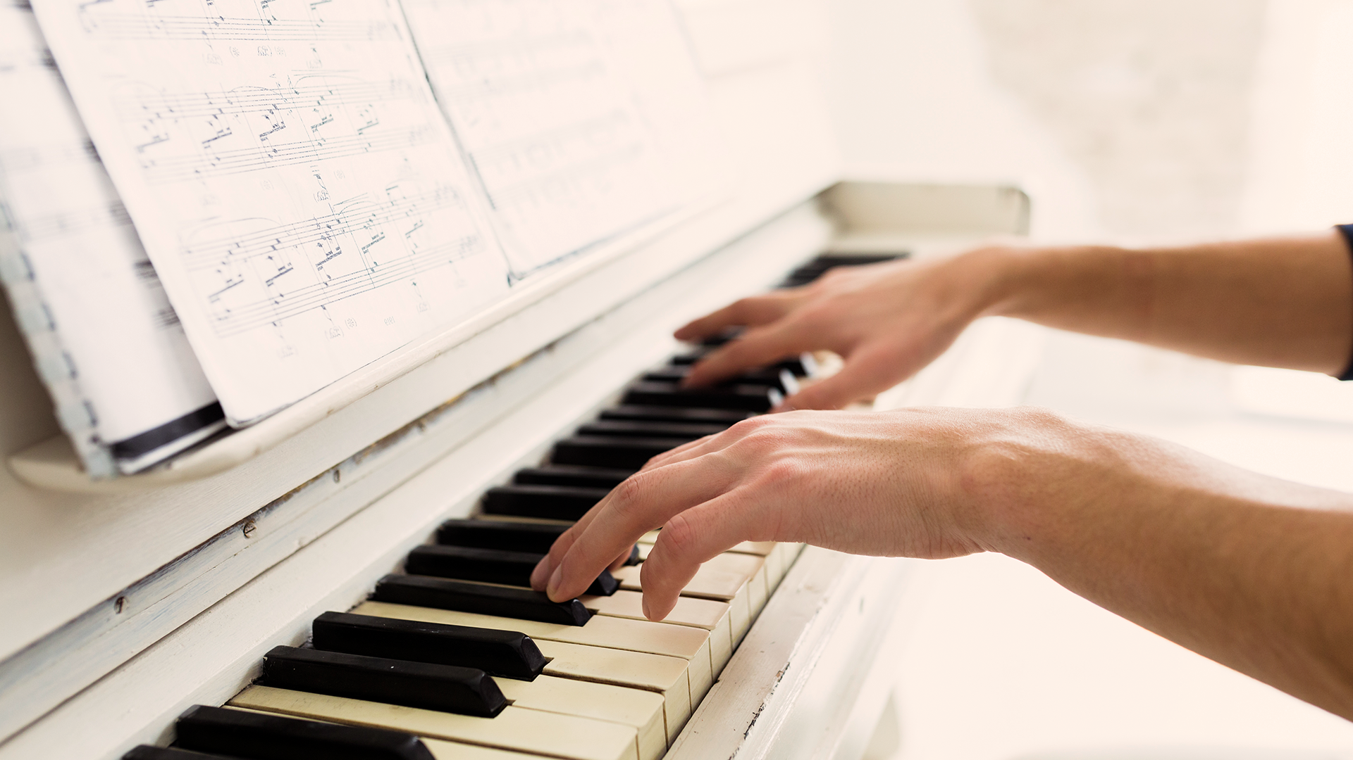
APPENDIX

Slide 17

PROBLEM STATEMENT - IMPORTANCE
MUSIC INDUSTRY IN US
Recorded music in the retail sector - $9.8 Bn in 2018
75% of music industry’s total revenue comes from streaming industry
Streaming services reached 50Mn subscriptions in US - first time in 2018 (Source: RIAA report)
Seamless listening experience would help capture a larger market - recommendation is key

Slide 18
DATA PREPROCESSING
Selected Punctuation
Removal
Stop words removal
Lower case conversion
Lemmatization

Slide 19
PUNCTUATION
CAPITALIZATION
DEGREE MODIFIERS
VADER ANALYZER - CONSIDERATIONS
CONNECTING WORDS
POLARITY NEGATION
Example Lyric
“oh yes it is me again the crazy one”
{'neg': 0.198, 'neu': 0.579, 'pos': 0.223, 'compound': 0.0772}
“oh yes! it is me again! the crazy one!” (pos:0.276)
“OH YES it is me again the crazy one” (pos:0.268)
“oh yes it is me again the sort of crazy one” (pos:0.188)
"oh yes it is me again but the crazy one" (neg: 0.239)
"oh yes it is me again the not crazy one" (pos:0.372,neg:0)

Slide 20
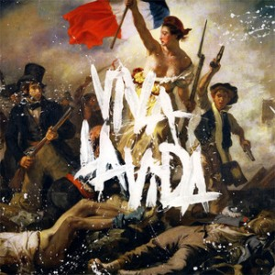
RECOMMENDATIONS
RECOMMENDATIONS
Song : Viva La Vida by Coldplay
Sentiment : Negative ( score - .92)
Topic : Spread across Topics 2, 3, 4
1
2
3
Ayo Technology by 50 Cent Ft. Justin Timberlake
Right Round by Flo Rida
All or Nothing by Milli Vanilli
Notes:
Bells ringing, choirs singing, wicked wild wind, sword and shield

